Slide 1
IIT Bombay
Page 1
Course Code : EE 611
Department: Electrical Engineering
Instructor Name: Jayanta Mukherjee
Email: jayanta@ee.iitb.ac.in
Lecture 6
EE 611 Lecture 6 Jayanta Mukherjee

Slide 2
IIT Bombay
Page 2
Maximally Flat (Binomial) Transformer
The maximally flat transformer is a N section transformer
It achieves broad-band matching by setting the reflection
coefficient and its N-1 derivatives to 0 at the center
frequency (θ = π/2)
EE 611 Lecture 6 Jayanta Mukherjee

Slide 3
IIT Bombay
Page 3
Binomial Solution
Many functions can be implemented
For a N-section maximally flat transformer we choose
The input reflection coefficient verifies Γ_{in}(π/2)=0
All the derivatives of Γ_{in}(θ) upto order N-1 vanish at θ=π/2
EE 611 Lecture 6 Jayanta Mukherjee

Slide 4
IIT Bombay
Page 4
Binomial Solution
EE 611 Lecture 6 Jayanta Mukherjee

Slide 5
IIT Bombay
Page 5
Binomial Transformer Bandwidth
EE 611 Lecture 6 Jayanta Mukherjee

Slide 6
IIT Bombay
Page 6
Binomial Transformer Bandwidth
EE 611 Lecture 6 Jayanta Mukherjee

Slide 7
IIT Bombay
Page 7
Fractional Bandwidth vs Number of
Sections
EE 611 Lecture 6 Jayanta Mukherjee

Slide 8
IIT Bombay
Page 8
Design of the transformer: finding the
Γ_{k}’s
So far we have just chosen a “maximally flat” function we would
like to have the reflection coefficient of our transformer to
produce. The next step is to find how the transformer can
actually produce this maximally flat reflection coefficient.
The binomial expansion formula is given by:
EE 611 Lecture 6 Jayanta Mukherjee

Slide 9
IIT Bombay
Page 9
Design of the transformer: finding the
Γ_{k}’s
Pascal’s Triangle
N/k | 0 1 2 3 4
0 | 1
1 | 1
2 | 1 2 1
3 | 1 3 3 1
4 | 1 4 6 4 1
EE 611 Lecture 6 Jayanta Mukherjee

Slide 10
IIT Bombay
Page 10
Design of the transformer: finding the
Γ_{k}’s
Applying the binomial expansion to our maximally flat
function we have
This is exactly of the same form as the input reflection
coefficient Γ_{in} of the multi-section network we analyzed in
the previous lecture using the small reflection approximation
EE 611 Lecture 6 Jayanta Mukherjee

Slide 11
IIT Bombay
Page 11
Attribute of the Reflection Coefficients
Note that the binomial transformer will produce symmetric
Γ_{k} ‘s because C_{k}^{N}=C^{N}_{N-k}
Notice that the C_{k}^{N} are always positive real numbers
However Γ_{L} can be positive or negative depending on whether
R_{L}>Z₀ or vice-versa
Thus the Γ_{k} ‘s are all either positive or negative and we should
have uniformly decreasing or increasing line impedances
Now that we know the Γ_{k} ‘s we need to determine the
characteristic impedances of the lines to obtain these Γ_{k} ‘s
EE 611 Lecture 6 Jayanta Mukherjee

Slide 12
IIT Bombay
Page 12
Approximate Method for Finding the Z_{k}’s
Since the Γ_{k} are given by Γ_{k} =(Z_{k+1}-Z_{k})/(Z_{k+1}+Z_{k}) we could write a
system of equations and solve it to find Z_{k} values.
Note that in this approximate theory we have actually more
equations than variables which is a reminder that our design is
approximate.
However, if Z_{k+1} is not too different from Z_{k} (required to keep our
theory of small reflections valid), we have seen that we can
approximate Γ_{k} by :
This is the recommended approach as it yields self-consistent
solution
EE 611 Lecture 6 Jayanta Mukherjee

Slide 13
IIT Bombay
Page 13
Approximate Method for Finding the Z_{k}’s
Since we know the Γ_{k}’s we can obtain the following expression
where the last expression is valid provided R_{L} and Z₀ are within
around a factor of 2 or ½.
We can step through the above equation starting at k=0 to find
all the impedance values in the transformer.
EE 611 Lecture 6 Jayanta Mukherjee

Slide 14
IIT Bombay
Page 14
2 Section Example
Let us consider a two section example N=2
Starting from
EE 611 Lecture 6 Jayanta Mukherjee
Notes:
14

Slide 15
IIT Bombay
Page 15
2 Section Example
The resulting characteristic impedances are then
Note that for k=2 solution using this method is not accurate.
This is due to the approximate nature of the design equations
we have derived. Pozar (pg 281) provides a table with more
accurate values.
EE 611 Lecture 6 Jayanta Mukherjee

Slide 16
IIT Bombay
Page 16
Design Example
Design a three section binomial transformer to match a load
R_{L}=100 ohms to a 50 ohm source. If a reflection coefficient of 0.1
is considered tolerable, what is the relative bandwidth obtained?
Since Γ_{m}=0.1,
EE 611 Lecture 6 Jayanta Mukherjee

Slide 17
IIT Bombay
Page 17
Design Example
EE 611 Lecture 6 Jayanta Mukherjee

Slide 18
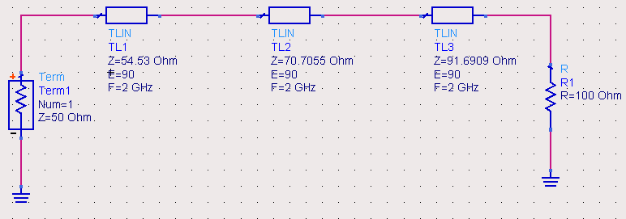
IIT Bombay
Page 18
Design Example
EE 611 Lecture 6 Jayanta Mukherjee

Slide 19
IIT Bombay
Page 19
Result
EE 611 Lecture 6 Jayanta Mukherjee

Slide 20
IIT Bombay
Page 20
Chebyshev Transformer
To improve on the maximally flat transformer we consider
next the Chebyshev transformer.
We will get more bandwidth for a given Γ_{in} if we allowed some
ripples inside the passband (i.e. between θ = θ_{m} and θ=π-θ_{m})
No perfect match at center
Frequency for N even
Γ_{in} has N zeros
EE 611 Lecture 6 Jayanta Mukherjee

Slide 21
IIT Bombay
Page 21
Chebyshev Polynomials
To derive a coefficient Γ(θ) with equal ripples we shall rely on the use
of Chebyshev polynomials T_{N}(x)
EE 611 Lecture 6 Jayanta Mukherjee

Slide 22
IIT Bombay
Page 22
Chebyshev Polynomials
These polynomials have the following properties.
The first three Chebyshev polynomials are given by:
Higher order polynomials can be found from
The Chebyshev polynomial verifies the property:
As a result we have |T_{N}(x)|<1 for |x|<1 and in this region the
Polynomials oscillate between +/- 1
EE 611 Lecture 6 Jayanta Mukherjee

Slide 23
IIT Bombay
Page 23
Application of Chebyshev Polynomials
If we map the range |x|<1 to the passband of our device, we can
design Γ to be less than Γ_{m} in the passband
For |x|>1,|T_{N}(x)|>1 and the reflection will be larger than Γ_{m}
outside the passband
The properties of these polynomials will give our transformer an
“equal-ripple” response in the passband
For this purpose we need to define x in terms of θ such that |x|=1
is mapped to the passband endpoints [θ_{m},π-θ_{m}]
One approach is to select:
EE 611 Lecture 6 Jayanta Mukherjee

Slide 24
IIT Bombay
Page 24
Application of Chebyshev Polynomials
The resulting reflection coefficient is
EE 611 Lecture 6 Jayanta Mukherjee

Slide 25
IIT Bombay
Page 25
Some Simplifications
We can determine A by taking θ=0:
We can then rewrite the reflection coefficient as:
The maximum reflection coefficient Γ_{m} is then related to θ_{m} by:
EE 611 Lecture 6 Jayanta Mukherjee

Slide 26
IIT Bombay
Page 26
Some Simplifications
Note that T_{N} (x = secθ_{m}) is always positive as we have
x = sec θ_{m}>1
Since we have Γ_{m}=|A|, we can rewrite in terms of Γ_{m}:
EE 611 Lecture 6 Jayanta Mukherjee

Slide 27
IIT Bombay
Page 27
BandWidth of Chebyshev Transformer
Equation
establishes a relationship between θ_{m} and Γ_{m} given the order
N and the load reflection coefficient Γ_{L}
Using an alternative definition for Chebyshev polynomials
Once θ_{m} is known, the fractional bandwidth is given by
EE 611 Lecture 6 Jayanta Mukherjee

Slide 28
IIT Bombay
Page 28
Design Procedure
We can use our earlier procedure of small reflections to find the
Z_{k} values from the Γ_{k} values
Γ_{k} values are determined by comparing our cosine series for
Γ_{in}(θ) with the corresponding Chebyshev polynomial.
For the design of 3rd and 4th order Chebyshev transformer we
can make use of the following identity
EE 611 Lecture 6 Jayanta Mukherjee

Slide 29
IIT Bombay
Page 29
3rd Order Example
With N=3, from our small reflection theory for symmetrical
transformers we have (Eqn 5.46 Pozar)
and from Chebyshev theory
Thus for this third order transformer we have
Note the symmetry of the reflection coefficients of the
Chebyshev transformer
EE 611 Lecture 6 Jayanta Mukherjee

Slide 30
IIT Bombay
Page 30
Design Example
Design a three section Chebyshev transformer to match a load
R_{L}=100 ohms to a 50 ohm source. If a reflection 0.1
Is considered tolerable, what is the relative bandwidth?
Since Γ =0.1,
EE 611 Lecture 6 Jayanta Mukherjee

Slide 31
IIT Bombay
Page 31
Design Example(2)
EE 611 Lecture 6 Jayanta Mukherjee

Slide 32
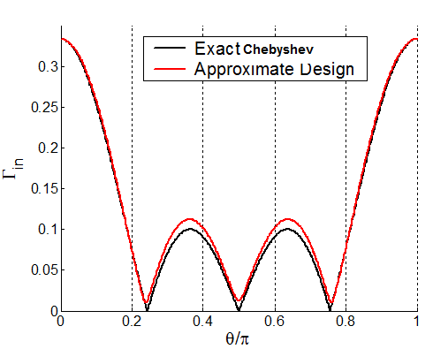
IIT Bombay
Page 32
Comparison of Approximate and
Desired Frequency Response
Exact results (including multiple reflections) from our
approximate design (neglecting multiple reflections) are
compared below with the desired
Chebyshev response.
Pozar has a table pg 286 to
assist in designing Chebyshev
transformers for Γ_{m}=0.05
and Γ_{m}=0.2
EE 611 Lecture 6 Jayanta Mukherjee

